Slide 1
Overview of Brightside Child & Family Advocacy
Presented by:
Kate Blair, Executive Director Ja’Nae Brown, Bright House Manager

Slide 2
Thirty Years of Advocacy
Since 1991, Savannah CASA has provided courtroom advocacy
Highly supportive judges who appoint CASA volunteers to every dependency case
CASA staff has developed specialties to provide better advocacy to children
We are expanding our organization with the new Bright House.

Slide 3
Organizational Progress

Slide 4
Our Strategic Plan
Strategic Priorities
The 2020-2022 Strategic Plan was created by a committee of staff, board, volunteers, and contracted facilitators. Several listening sessions were conducted that included DFCS, Juvenile Court, and community partners.
GROWTH & EXPANSION
INCREASE FUNDING & RESOURCES
Increase the number of children served
Implement new services
Increase overall funding by 20% annually
Diversify overall funding sources
Ensure fiscal responsibility of the organization
ENHANCE VOLUNTEER ADVOCACY
IMPROVE STAKEHOLDER RELATIONSHIPS
Increase number of volunteers by 100%
Improve volunteer advocacy
Provide referrals to community services to volunteers
Increase diversity among volunteers
Increase public awareness
Strengthen relationship with DFCS
Strengthen relationship with the Juvenile Court
Develop community partnerships
BOARD & STAFF DEVELOPMENT
Improve employee retention
Improve diversity of the board and staff
Improve board engagement

Slide 5
The Savannah CASA Program

Slide 6
What is a CASA Volunteer?
Court Appointed Special Advocates (CASA) are volunteers appointed by the Chatham County Juvenile Court to advocate for the best interests of children who have experienced abuse or neglect.

Slide 7
Being a CASA
A CASA Volunteer:
Spends time monthly with their assigned child(ren).
Has access to all of the child(ren)’s records.
Speaks with teachers, family members, counselors, caseworkers, medical professionals, foster parents, etc.
Evaluates all areas of the child’s life to ensure that their needs are being met educationally, emotionally, psychologically, and physically.

Slide 8
Supervised Visitation & Family Support

Slide 9
Today, there are 308 CHILDREN in foster care in Chatham County.
93% served by Savannah CASA

Slide 10
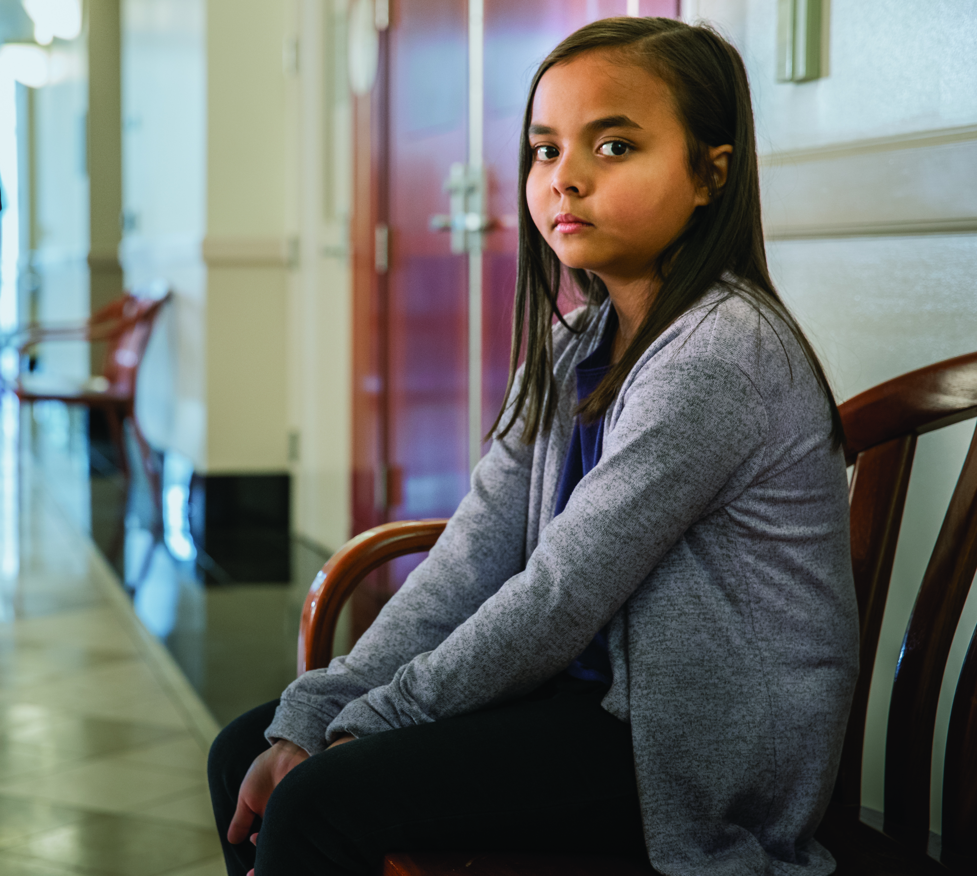
Foster Care in Chatham County
Reasons for removal
Neglect - 13%
Caretaker drug and alcohol use - 30%
Physical abuse - 5%
Inability to cope - 36%
Inadequate housing - 14%
Incarceration - 2%
Child behavior - 20%
Abandonment – 10%

Slide 11
Foster Care in Chatham County
Exiting Foster Care
Reunification – 38%
Adoption - 18%
Emancipation - 19%
Guardianship - 17%
Median length of stay in foster care – 27.6 months
Median length of stay in foster care before reunification – 14.7 months

Slide 12
Reunifying Families
When a child enters foster care due to abuse or neglect, it is often caused by generational trauma, mental health concerns, stress caused by poverty, or substance use of the parent. Ideally, these causes can be addressed and the child returned home.
Reunification is the preferred and most common outcome for children in foster care.

Slide 13
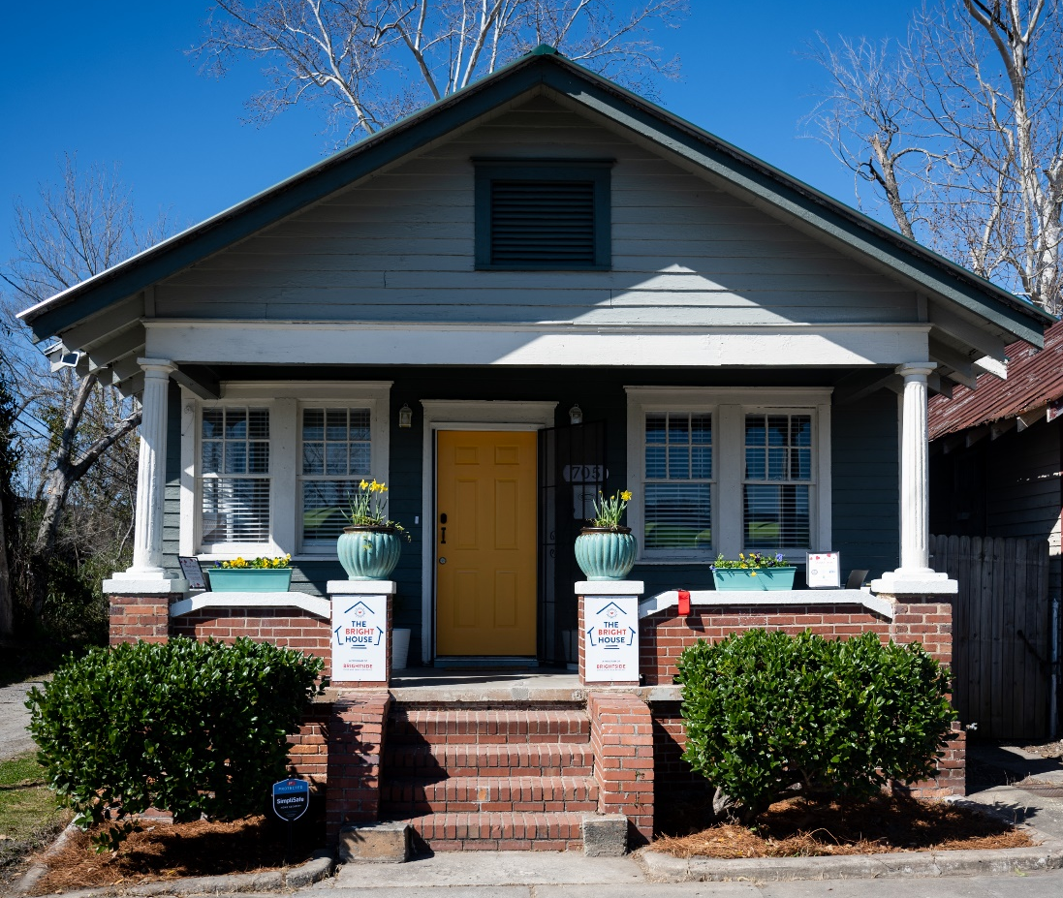
Healing Families Through Supervised Visitation
The Benefits of Supervised Visitation
Strengthens parent-child attachments
Decreases sense of abandonment
Less time in out-of-home care
The Bright House Offers
Minimally invasive supervised visitation
Parental coaching
Community resource referral

Slide 14
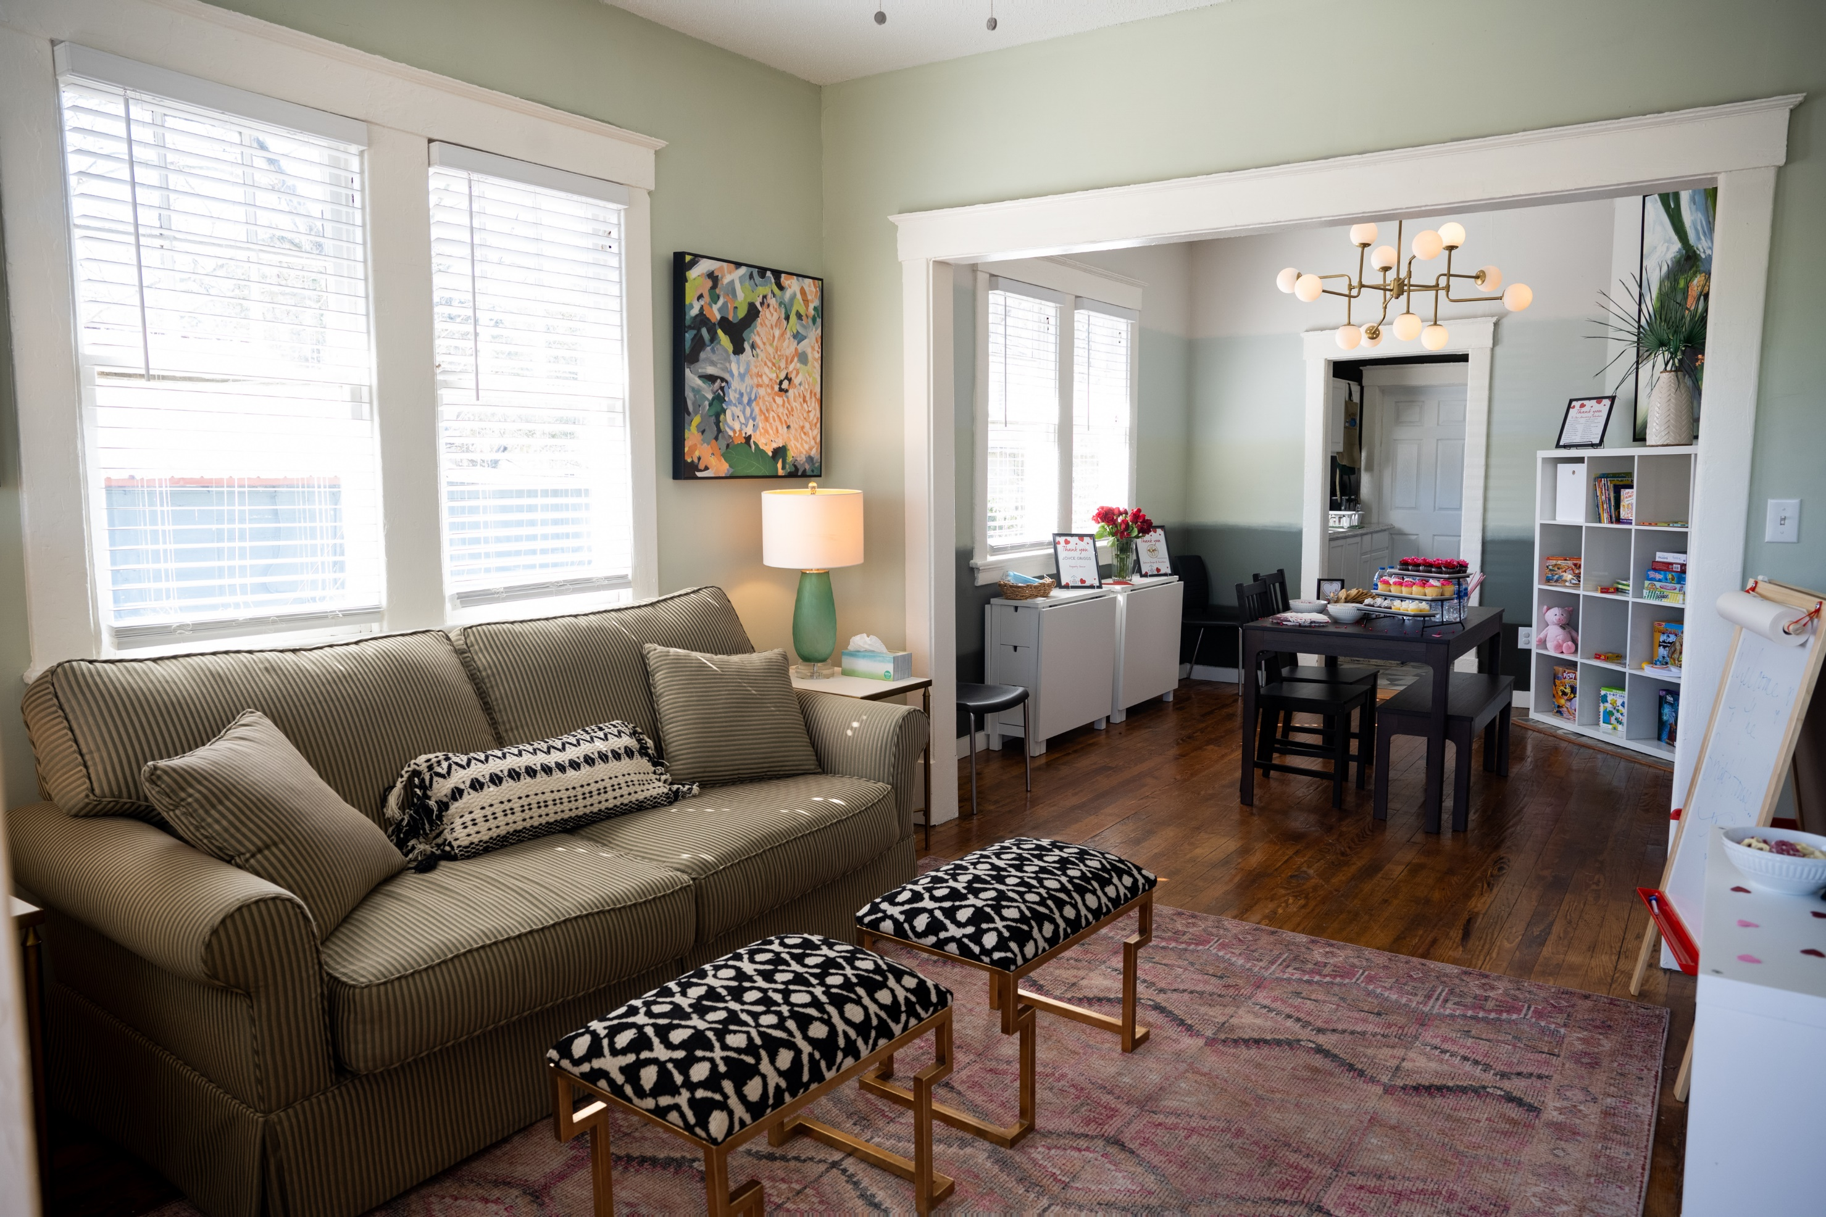

Slide 15
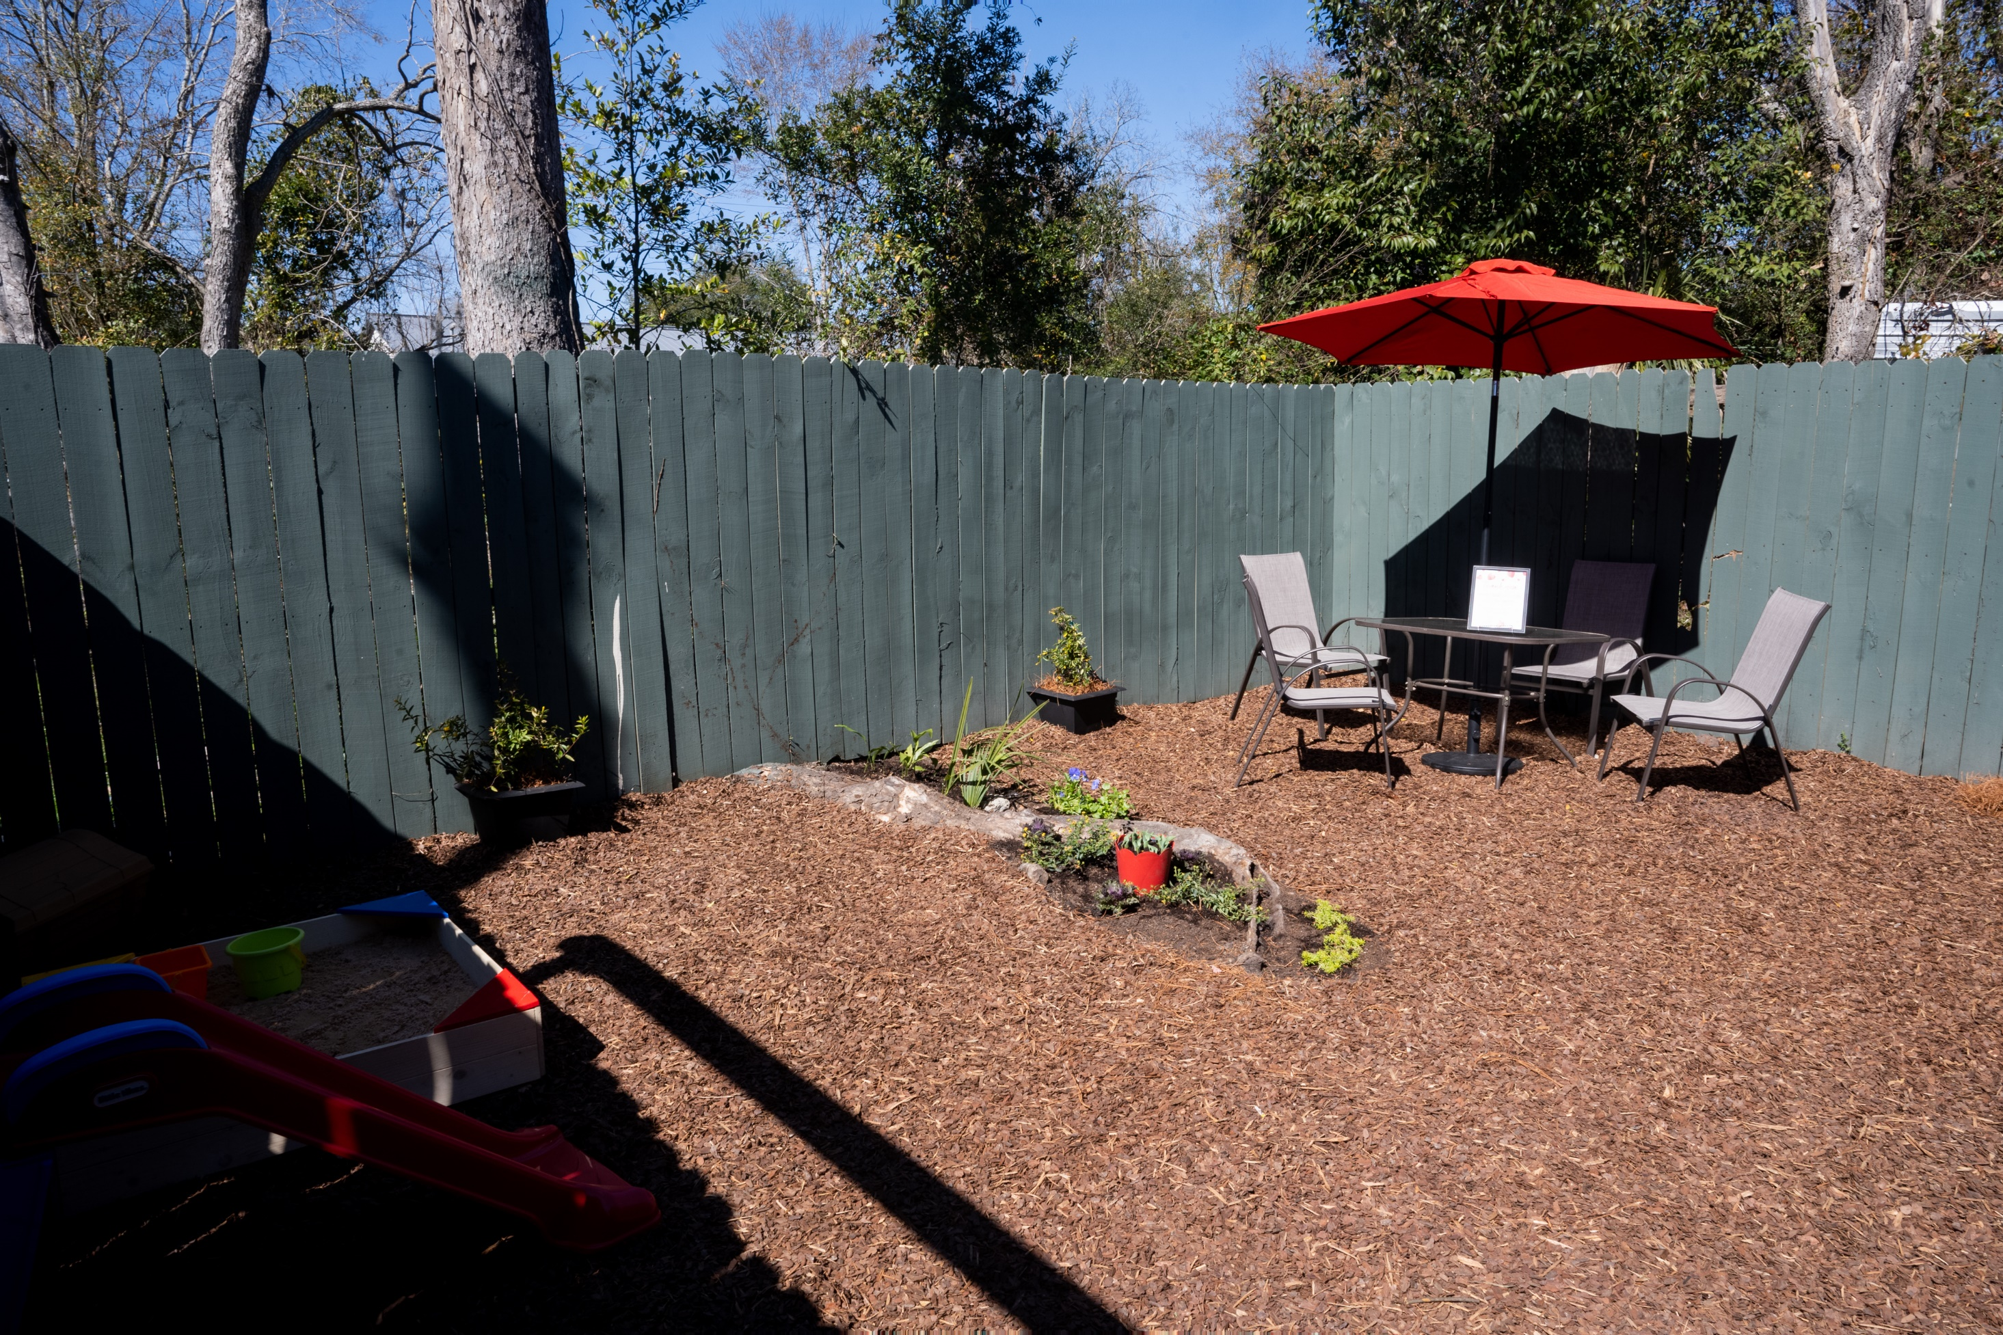

Slide 16
Healing Families Through Supervised Visitation
The Bright House at 705 Harmon
Open 7 days a week from 10 am to 6pm
Typically 2 hour visitations 1-2 visits per week
Ability to serve up to 18 families
Only morning shifts remaining open

Slide 17
Thank You

